Slide 1
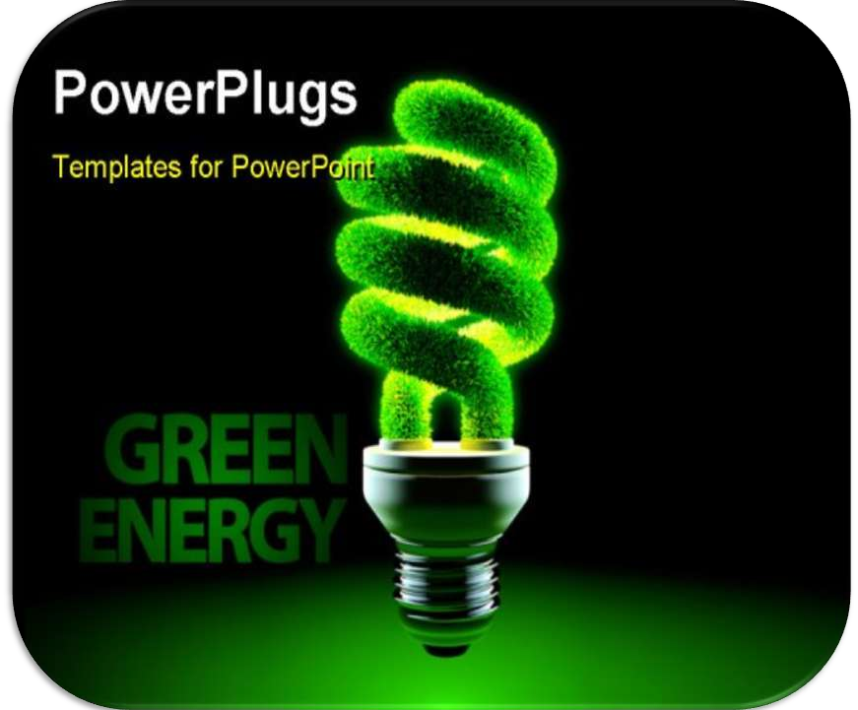
NON CONVENTIONAL
ENERGY

Slide 2
What is energy?
Energy is the key input to drive and improve the life cycle.

Slide 3
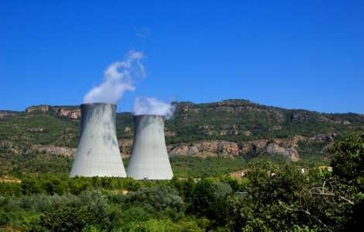
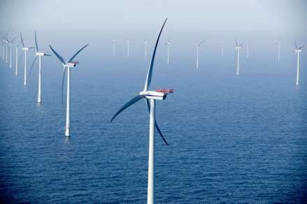
TYPES OF ENERGY?
◆ CONVENTIONAL ENERGY
◆ NON CONVENTION ENERGY

Slide 4
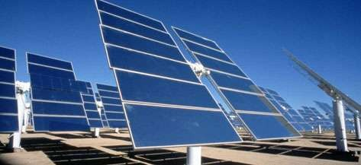
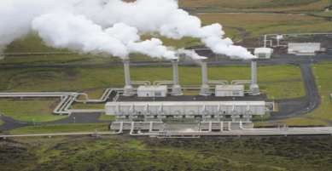
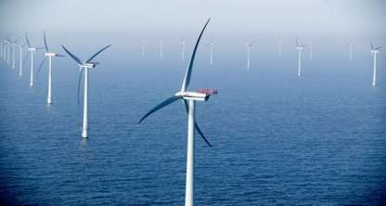
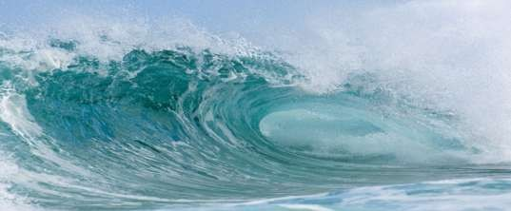
NON CONVENTIONAL SOURCE OF ENERGY
RENEWABLE SOURCE OF ENERGY

Slide 5
CONTENTS
INTRODUCTION
SOLAR ENERGY
SOLAR COOKER
SOLAR PHOTOVOLTAIC CELL
SOLAR WATER PUMPS
WIND ENERGY
BIOMASS AND BIOENERGY
BIOFULES
OCEAN ENERGY
TIDAL ENERGY
GEO THERMAL ENERGY
HYDROPOWER ENERGY
CONCLUSION

Slide 6
INTRODUCTION
INDIA ranked sixth in the world in total energy
consumption.INDIA has installed power capacity capacity from 1262 megawatt to over 112.058megawatt.this achievement is impressive but not sufficient
So we mostly needed renewable source of energy.
Concept of Renewable Energy
Renewable energy sources also called non-conventional energy, are sources that are continuously
replenished by natural processes.
Solar energy Wind energy Bio energy Hydro energy
Geothermal energy
Wave and tidal energy

Slide 7
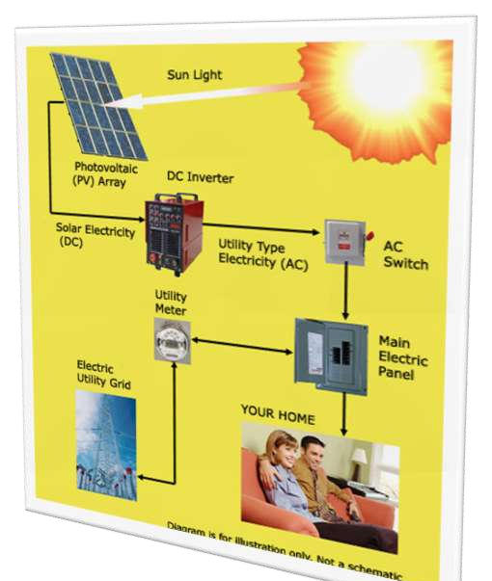
SOLAR ENERGY
Solar energy has the greatest potential of all the so Solar energy has the greatest potential of all the sources of renewable energy and if only a small amount of this form of energy could be used, it will be one of the most important supplies of energy specially when other sources in the country have depleted energy comes to the earth from the sun. This energy keeps the temperature of the earth above than in colder space, causes current in the atmosphere and in ocean, causes the water cycle and generate photosynthesis in plants.

Slide 8
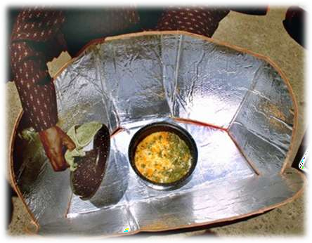
SOLAR COOKER
Solar cooker is a device, which uses solar energy for cooking, and thus saving fossil fuels, fuel
wood and electrical energy to a large extent. However, it can only supplement the cooking fuel, and not replace it totally. It is a simple cooking unit, ideal for domestic cooking during most of
the year except during the monsoon season, cloudy days and winter months
Application of Non-Conventional & Renewable Energy Sources

Slide 9
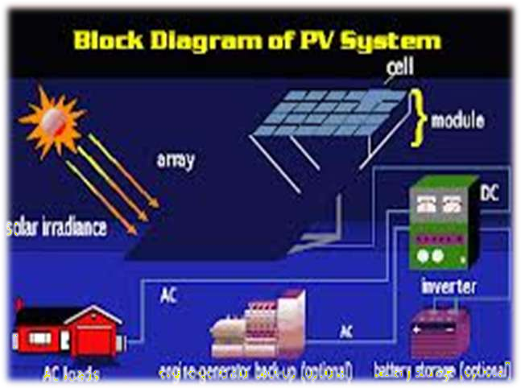
SOLAR PHOTOVOLTAIC CELL
Photovoltaic is the technical
term for solar electric. Photo means "light" and
voltaic
means "electric". PV cells are usually made of silicon,
an element that naturally releases electrons when
exposed to light. Amount of electrons released from silicon cells depend upon intensity of light incident on it. The silicon cell is covered with a grid of metal that directs the electrons to flow in a path
to create an electric current. This current is guided into a wire that is connected to a battery or DC appliance.
Typically, one cell produces about 1.5 watts of power. Individual cells are connected together to form a
Application of Non-Conventional & Renewable Energy Sources

Slide 10
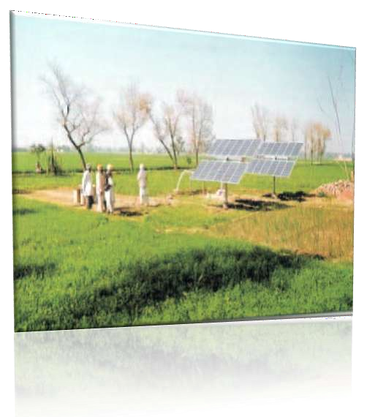
SOLAR WATER PUMPS
In solar water pumping system, the pump is driven by
motor run by solar electricity instead
of conventional electricity drawn from utility grid. A SPV water pumping system consists of
a photovoltaic array mounted on a stand and a motor- pump set compatible with the photovoltaic
array. It converts the solar energy into electricity, which is used for running the motor
pump set. The pumping system draws water from the open well, bore well, stream, pond,
canal etc
. Application of Non-Conventional & Renewable Energy
Sources

Slide 11
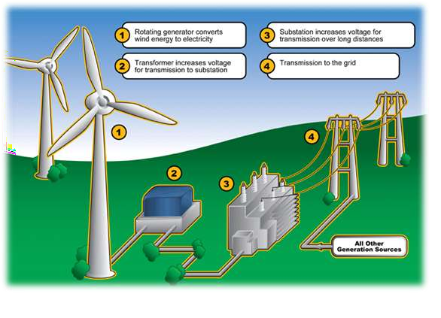
WIND ENERGY
Wind energy, which is an indirect source of solar energy conversion, can be utilized to run windmill, which in turn drives a generator to produce electricity. Wind can also be used to provide mechanical power such as for water pumping.
The basic wind energy conversion device is the wind turbine
Vertical-axis wind turbines
2. Horizontal-axis turbines
Wind electric generator converts kinetic energy available in wind to electrical energy by using rotor, gear box and generator. There are a large
number of manufacturers for wind electric generators
1. APPLICATIONS
an electrical submersible pump directly.
Wind turbines for remote water pumping generate 3 phase AC current suitable for driving.
WIND energy are used to reduce utility bills by displacing the utility power used in the household

Slide 12
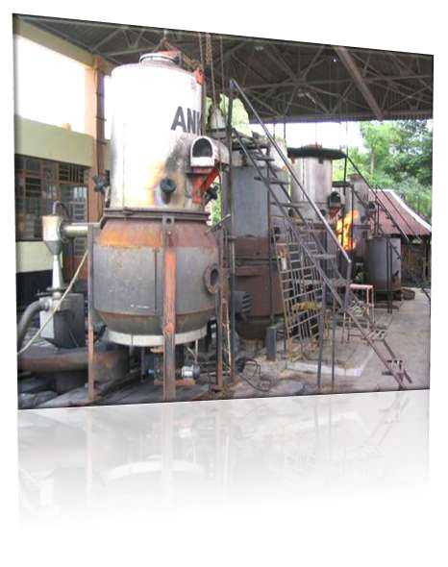
BIOMASS AND BIOENERGY
The potential for application of biomass, as an alternative source of energy in India is large. We have plenty of agricultural and forest resources for production of biomass. Biomass is produced in nature through photosynthesis achieved by solar energy conversion. As the word clearly signifies Biomass means organic matter. In simplest form, the process of photosynthesis is in the presence of solar radiation

Slide 13
BIOFULES
Unlike other renewable energy sources, biomass can be converted
directly into liquid fuels— biofuels— for our transportation needs
(cars, trucks, buses, airplanes, and trains). The two most common
alternative fuel for diesel engines. Application of Non-Conventional & Renewable Energy Sources

Slide 14
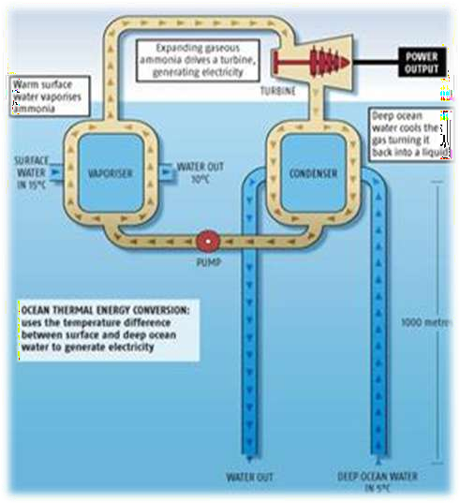
OCEAN ENERGY
Oceans cover more than 70% of Earth's surface, making them the world's largest solar collectors.
Ocean energy draws on the energy of ocean waves, tides, or on the thermal energy (heat) stored in the ocean. The sun warms the surface water a lot more than the deep ocean water, and this temperature difference stores thermal energy.
The ocean contains two types of energy: thermal energy from the sun's heat, and mechanical energy from the tides and waves.
Ocean thermal energy is used for many applications, including electricity generation.
There
are three types of electricity conversion systems: closed-cycle, open cycle, and hybrid. Closed

Slide 15
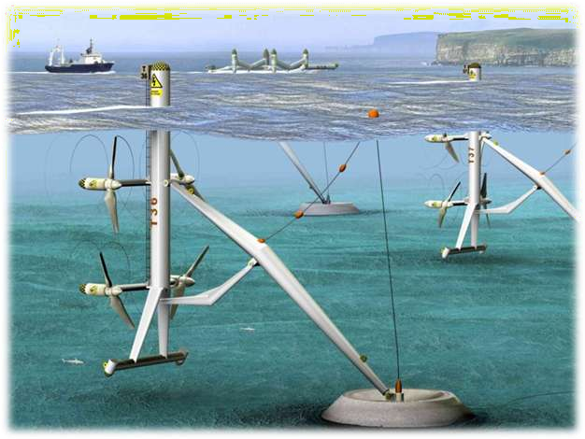
TIDAL ENERGY
The tides in the sea are the result of the universal gravitational effect of heavenly bodies like sun and moon on the earth. Due to fluidity of water mass, the effect of this force becomes apparent in the motion of water, which shows a periodic rise and fall in levels which is in synthesis with the daily cycle of rising and setting of sun and moon. This periodic rise and fall of the water level of sea is called tide. These tides can be used to produce electrical power which is known as tidal power
By using reversible water turbines, turbines can be run continuously, both during high tide and low tide. The turbine is coupled to generator, potential energy of the water stored in the basin as well as energy during high tides used to drive turbine, which is coupled to
generator, generating electricity

Slide 16
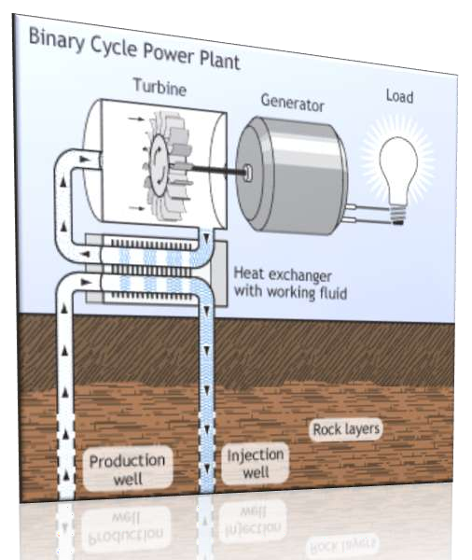
GEO THERMAL ENERGY
This is the energy, which lies embedded with in the earth. According to various theories the earth has a molten core. The steam and the hot water comes naturally to the surface of the earth in some locations of the earth. Two ways of electric power production from geothermal energy has been suggested.
as between 450 to 550⁰C can be found. By embedding coil of pipes and sending water through them can be raised. In the other, the hot geothermal water and or steam is used to operate the turbines directly. At present only steam coming out of the ground is used to generate electricity

Slide 17
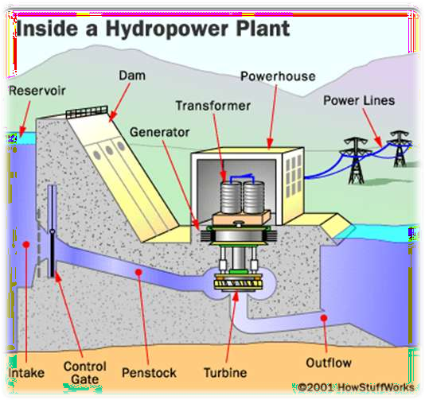
SMALL HYDROPOWER ENERGY
Energy from small hydro is probably the oldest and yet, the most reliable of all renewable energy sources. The term ‘small hydro’ has a wide range in usage, covering schemes having installed capacities from a few kW to 25 MW. In India small hydro schemes are further classified as micro hydro up to 100 kW plant capacity, mini hydro from 101 kW to 2000 kW and small hydro up to 25000 kW plant capacity. The advantage of this resource is that it can be harnessed almost every where in India from any nearby stream or canal – in the most environmentally benign manner, and without encountering any submergence, deforestation or resettlement problems which are generally encountered in the development of large hydro power

Slide 18
CONCLUSION
The demand of energy is growing owing to the development. Due to the problems associated with the development of conventional sources of energy, the focus is now being shifted to renewable energy sources. India has potential of renewable energy source in abundance, which if developed properly can augment the growing demand of the energy. There is a need to make full use of renewable energy technologies to harness the untapped potential in cost effective manner and fulfill the energy demand.

